Slide 1
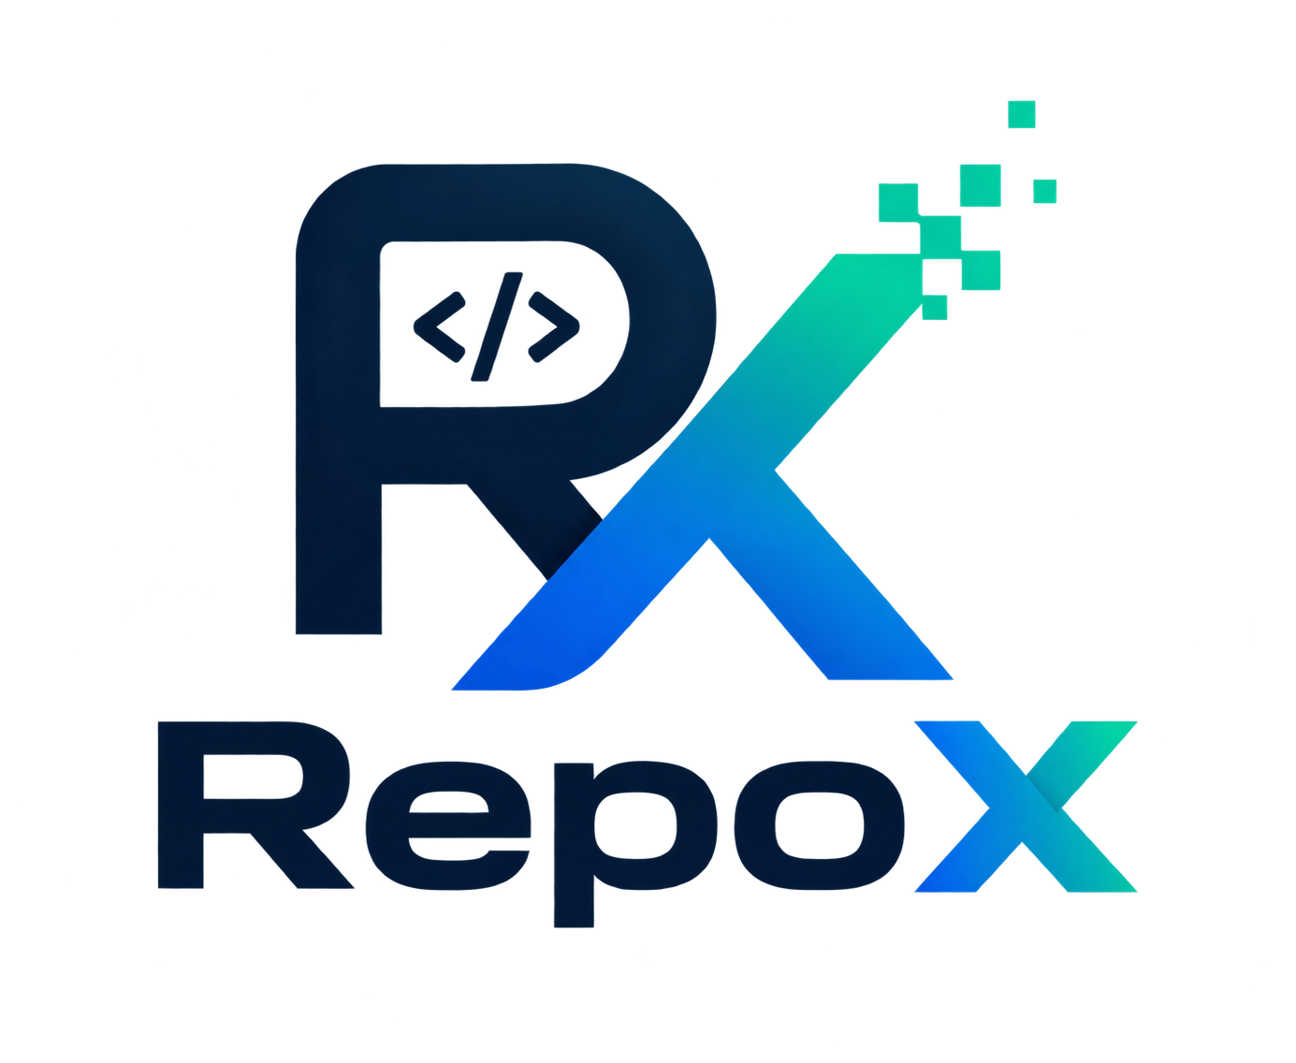


SMART INDIA HACKATHON 2026
Problem Statement ID: SIH26094
Problem Statement Title: AI-Powered Dynamic Mental Health Monitoring and Distress Prediction System for Victims of Atrocities
Theme: MedTech / BioTech / HealthTech
PS Category: Software
Team ID: [Team ID]
Team Name: RepoX

Slide 2
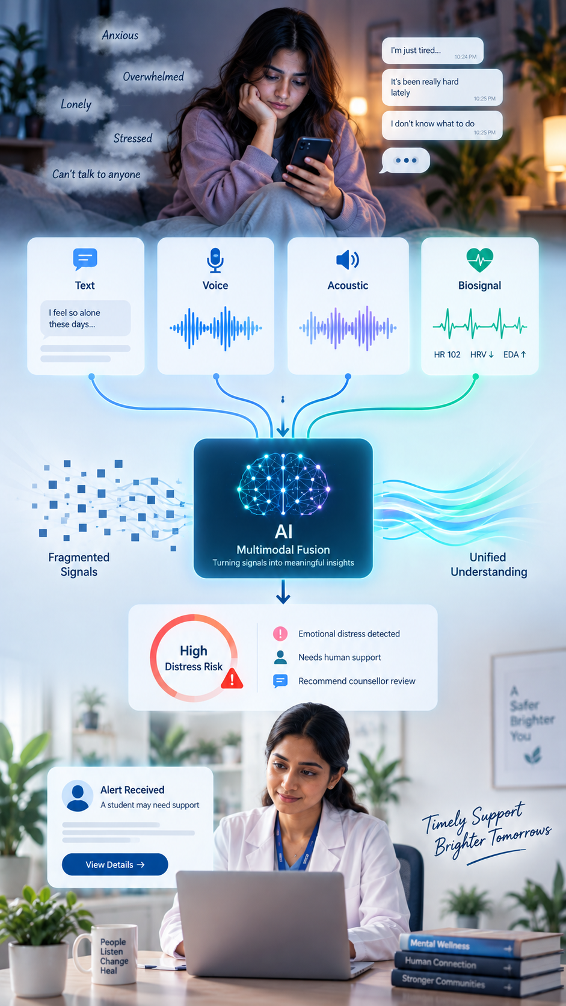
MANN-SATHI
Proposed Overview
1. Hidden distress
- Emotional distress often remains unspoken.
2. Scattered signals
- Text, voice and physiological signals tell different parts of the story.
3. Late intervention
- Counsellors may see escalation only after it becomes serious.
Proposed Solution
1. Multimodal AI
- Text + Voice + Acoustic + Biosignal
2. Dynamic distress tracking
- Continuous score across interactions
3. Human-in-the-loop
- High-risk cases reach counsellors
4. Supportive AI
- Conversation + motivation + resources
5. Secure case ecosystem
- Cases • Documents • Appointments • Support

Slide 3
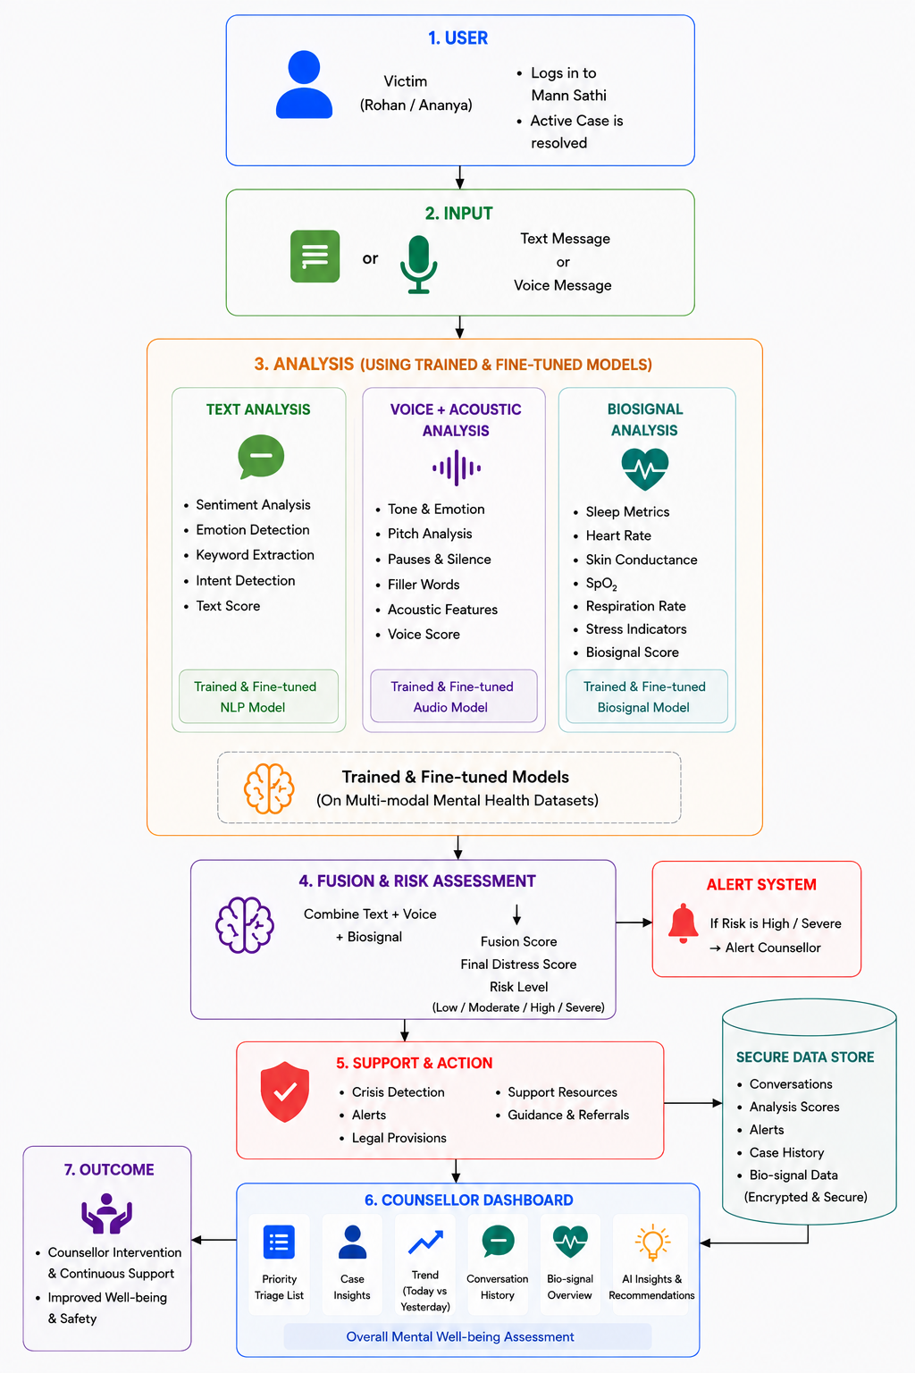
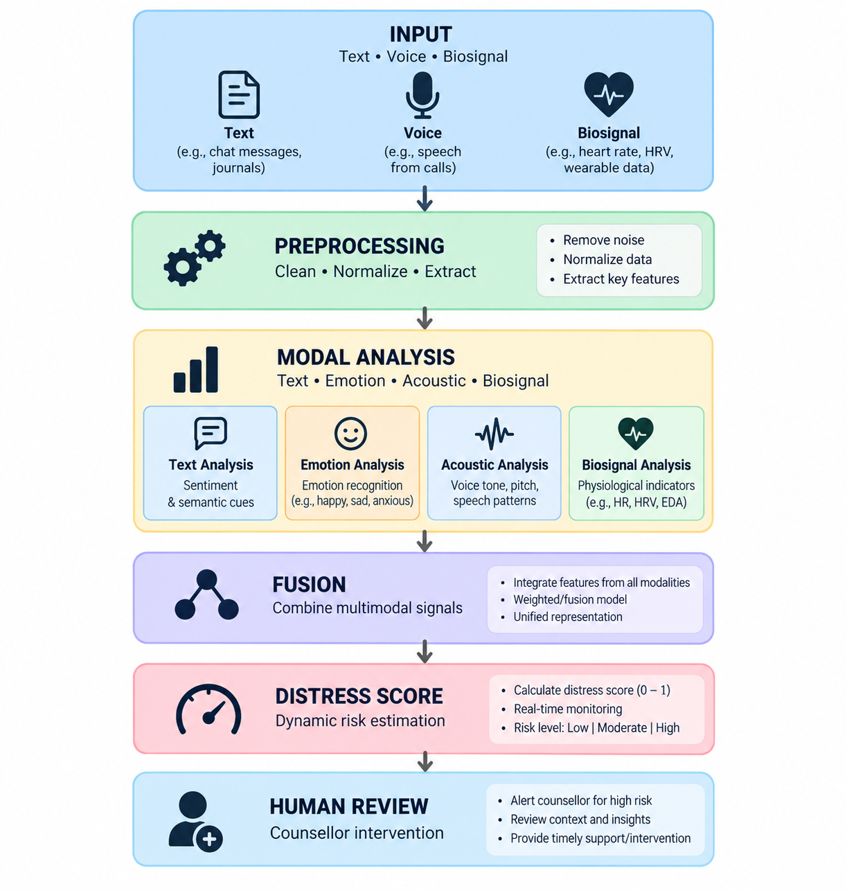
TECHNICAL APPROACH
Methodology
SYSTEM FLOW

Slide 4







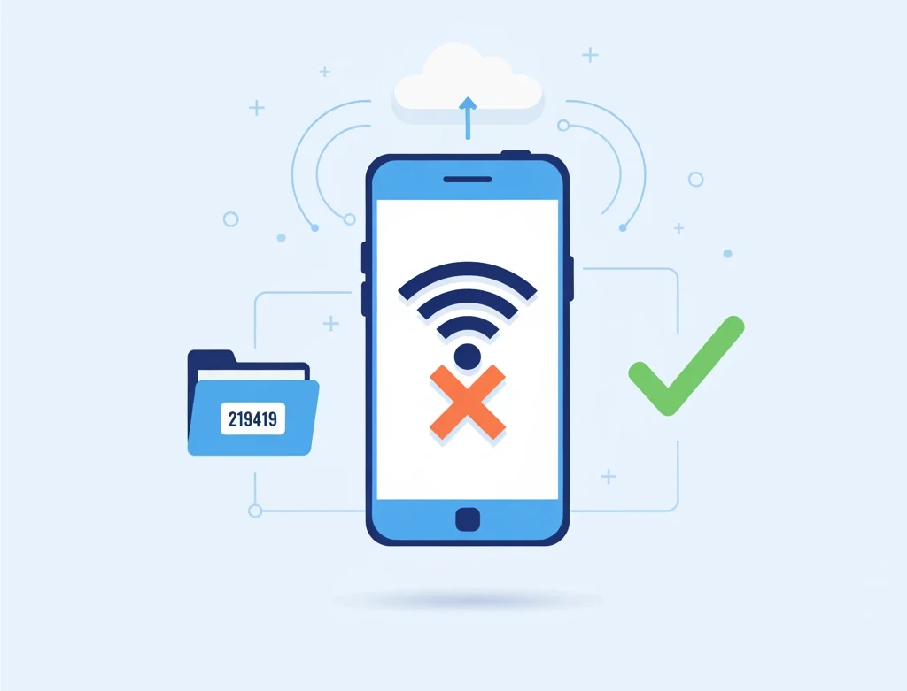
FEASIBILITY AND VIABILITY
1. Technical Feasibility
Built on mature, well-documented tech (multilingual NLP, LSTM prediction, Twilio SMS/IVR), so a working prototype is achievable quickly and scales on standard cloud infrastructure.
2. Economical Feasibility
Costs scale with usage (compute + SMS fees) rather than heavy upfront investment; automating triage reduces the cost-per-person of mental health outreach for NGOs/governments.
3. Social Feasibility
Offline-first, local-language design meets survivors where they are; delivery through already-trusted NGOs and transparent consent improves acceptance despite surveillance concerns.
4. Security Feasibility
On-device/federated processing and end-to-end encryption keep raw sensitive data local, minimizing breach impact — backed by ongoing security audits given the stakes.
Potential Challenges & Risks
Strategies For Overcoming These Challenges
Data privacy & breach risk — sensitive data on vulnerable populations could be catastrophic if leaked or misused
Cultural & linguistic bias — non-representative data risks misreading distress across groups.
Privacy-by-design architecture — on-device processing + encryption to minimize breach risk.
Community-calibrated models — local NGO input to reduce bias.
False positives/negatives in prediction — misclassified risk delays real help or causes false alarms.
Low digital access & trust deficit — limited connectivity and surveillance wariness hinder adoption.
NGO-led trust building & offline access — SMS/IVR + trusted partners for reach and trust.

Slide 5








IMPACT AND BENEFITS
Impacts
Benefits
Earlier crisis prevention — distress detected before it escalates to breakdown or self-harm.
Wider mental health coverage — reaches survivors who would otherwise go undetected or untreated.
Reduced burden on scarce professionals — AI triage directs limited counselor time to highest-need cases.
Improved recovery outcomes — continuous tracking enables timely, personalized intervention.
Low-cost, scalable deployment — SMS/IVR keeps reach high without expensive infrastructure.
Accessible without stigma — passive monitoring helps those unwilling to self-report.
Data-informed planning — anonymized trends help NGOs allocate resources efficiently.
Privacy-first design — on-device processing and encryption protect vulnerable users' data

Slide 6
RESEARCH AND REFERENCES
1. WHO | Psychological Self-Help Interventions, 2026
Evidence-based digital/self-help approaches can expand access to mental-health support, including in low-resource settings.
WHO — Psychological Self-Help Interventions
2. WHO | Mental Health in India, 2022
Provides India-specific context on mental-health needs and strengthening mental-health systems.
WHO — Addressing Mental Health in India
3. Multimodal Emotion Recognition Review
Research supports combining multiple modalities for richer emotion recognition than relying on a single signal.
PubMed — Multimodal Emotion Recognition Review
4. ResearchGate — Mental Health Research in India: New Challenges and the Way Forward (2021) — India-specific context on mental health research gaps and priorities.
Link:https://www.researchgate.net/publication/353003183_Mental_Health_Research_in_India_New_Challenges_and_the_Way_Forward
5. WHO Transdiagnostic Digital Intervention (2025) — fictional-character conversational tool addressing low mood, stress, and anger from everyday stressors, adaptable across LMIC populations.
Link:https://www.medrxiv.org/content/10.1101/2025.02.19.25322432.full.pdf
Technology Sources: Hugging Face • PyTorch • FastAPI • Supabase

